Slide 1

The Two Step Method: Accurate Record Keeping for Sex and Gender
By Trystan Washburne
University of Stirling

Slide 2



Censuses in the 2020s
--Canada, 2021
--Scotland, 2022
--New Zealand, 2023
--All three nations asked both sex and gender questions
--For Canada and Scotland, it was the first time gender questions were included (New Zealand had one in 2015)

Slide 3
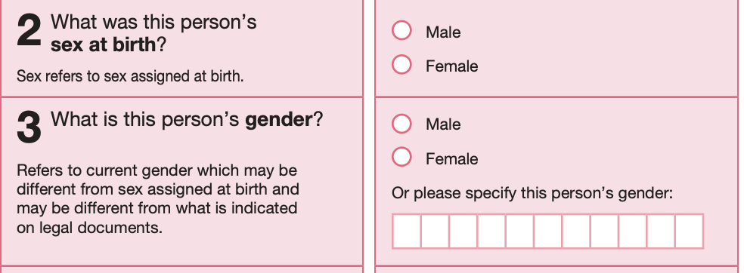
Canada, 2021

Slide 4
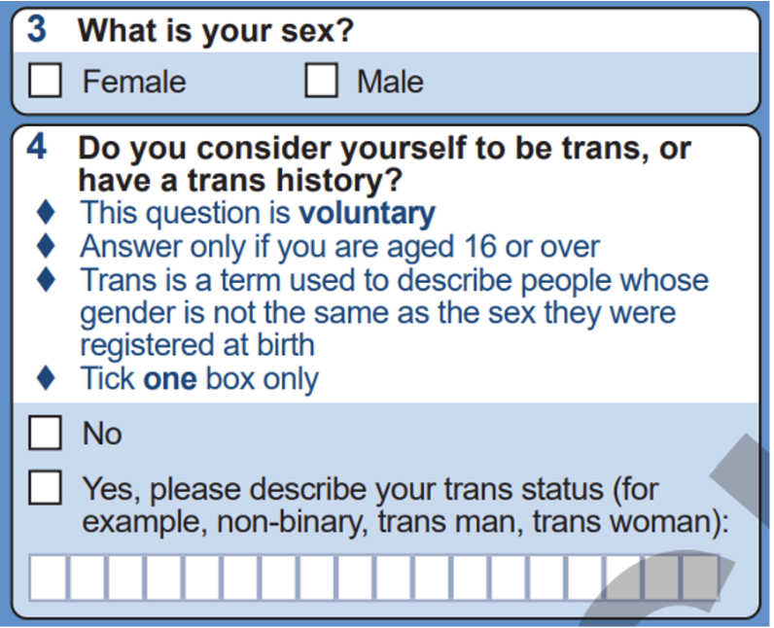
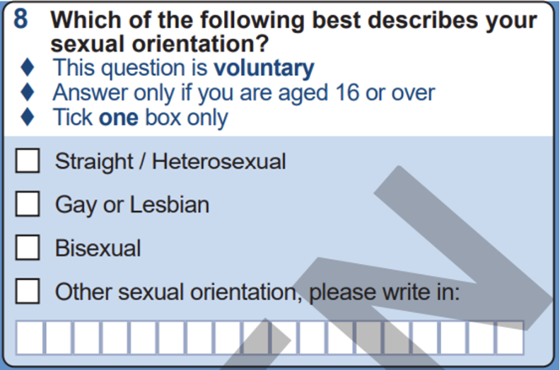
Scotland, 2022

Slide 5
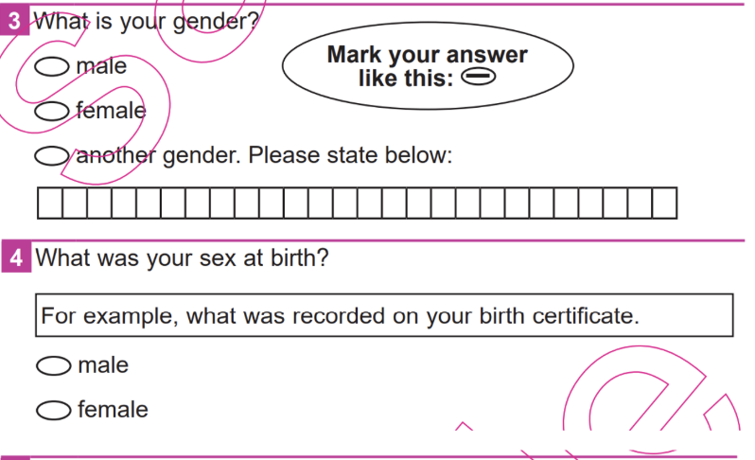
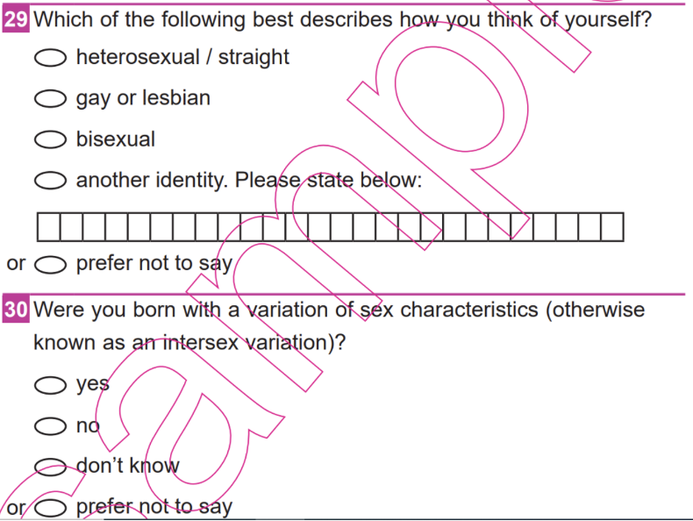
New Zealand, 2023

Slide 6
What makes sex and gender questions not work?

Slide 7
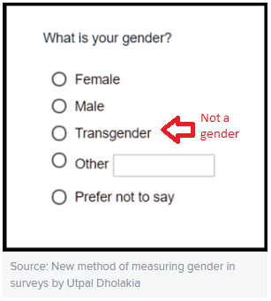
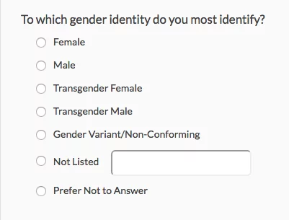
Listing ‘transgender’ as a gender option

Slide 8
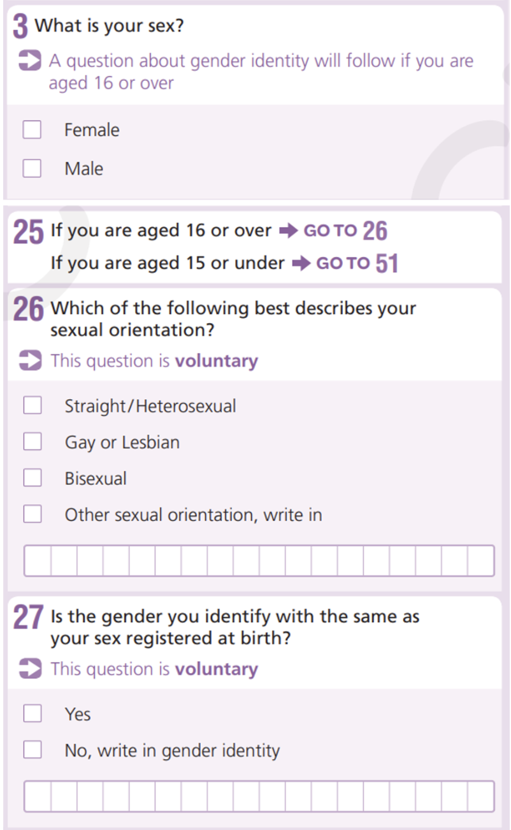
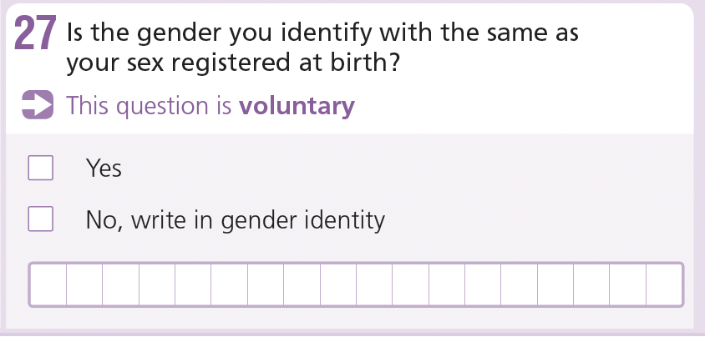
Overly wordy or complicated questions

Slide 9
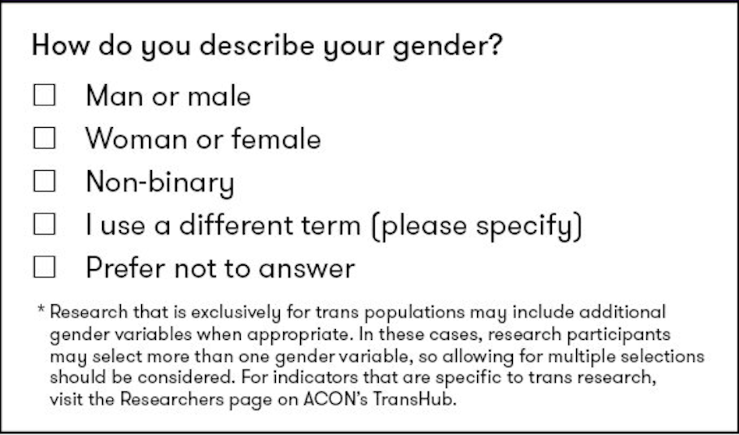
The Two Step Method: Step One
Ask a question about gender

Slide 10
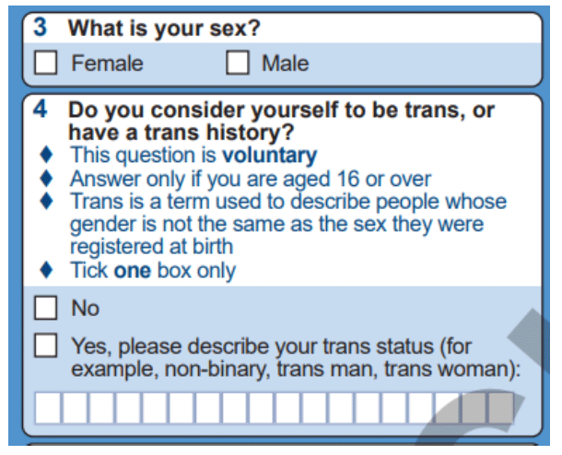
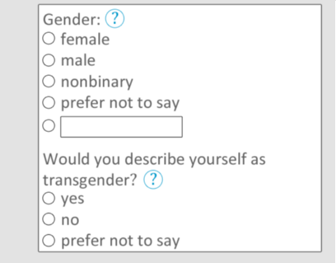
The Two Step Method: Step Two
Ask a question about trans history

Slide 11
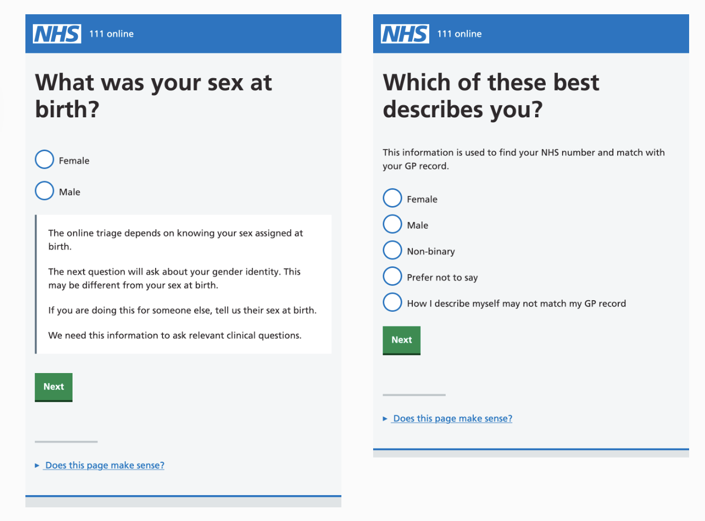

Slide 12
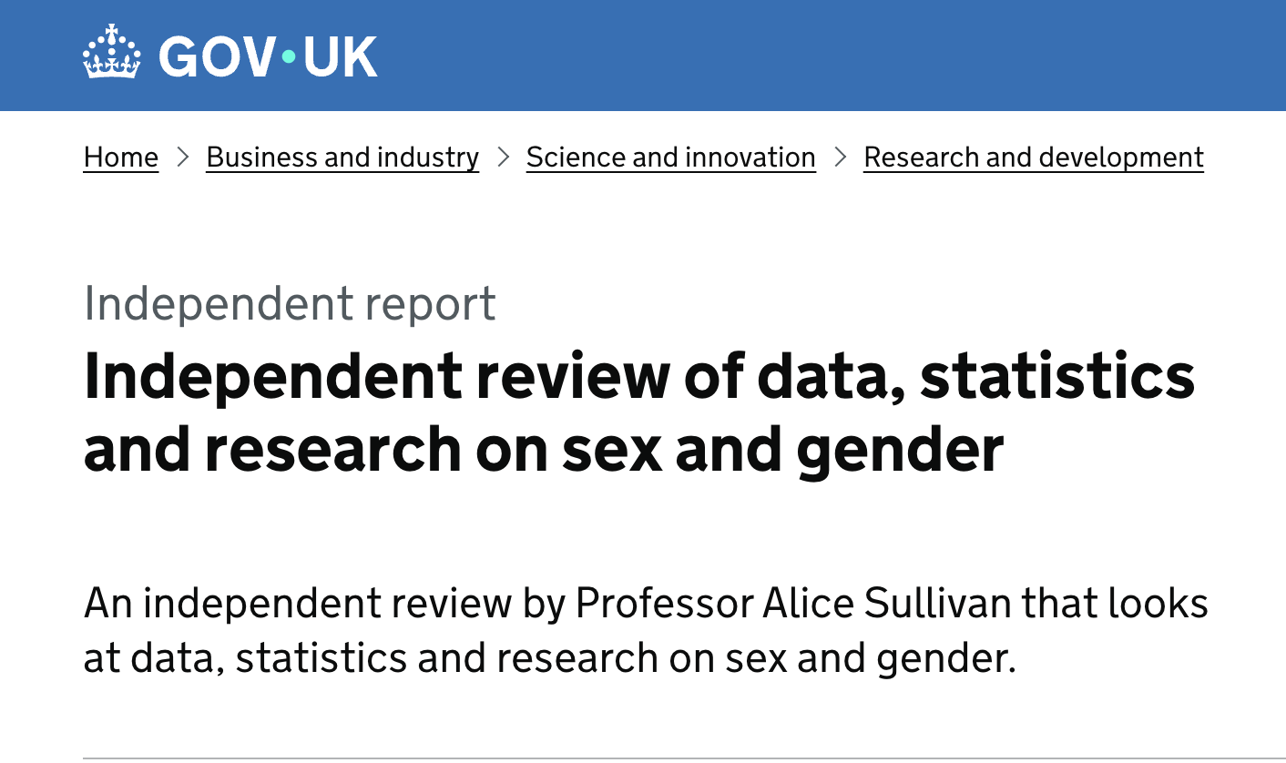

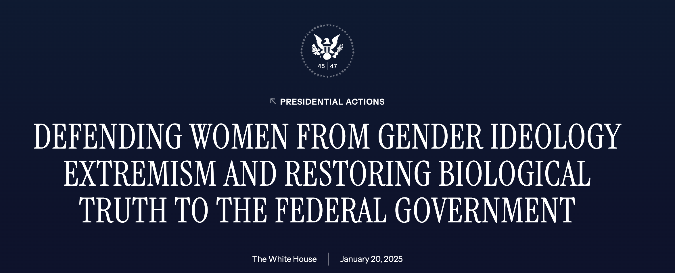
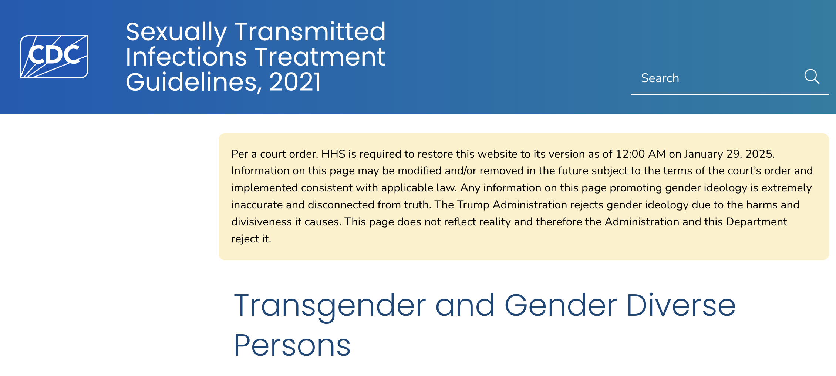
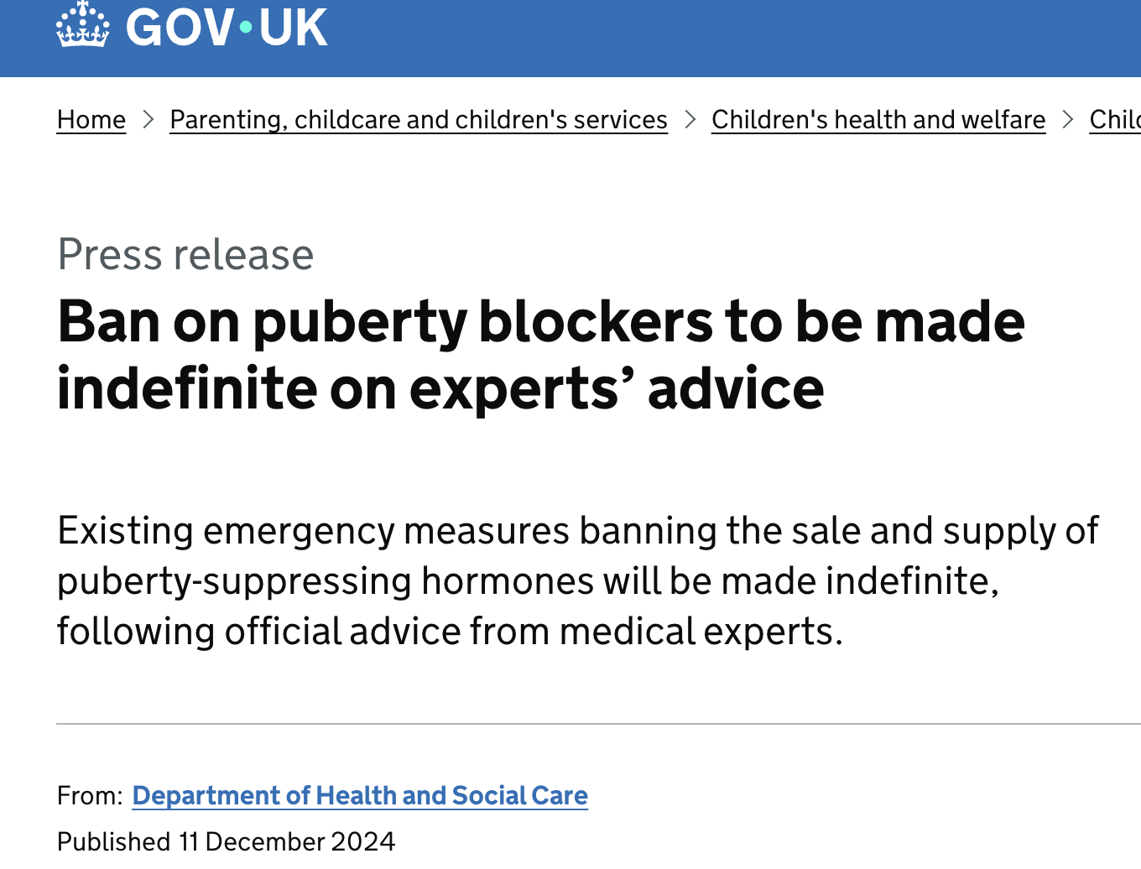

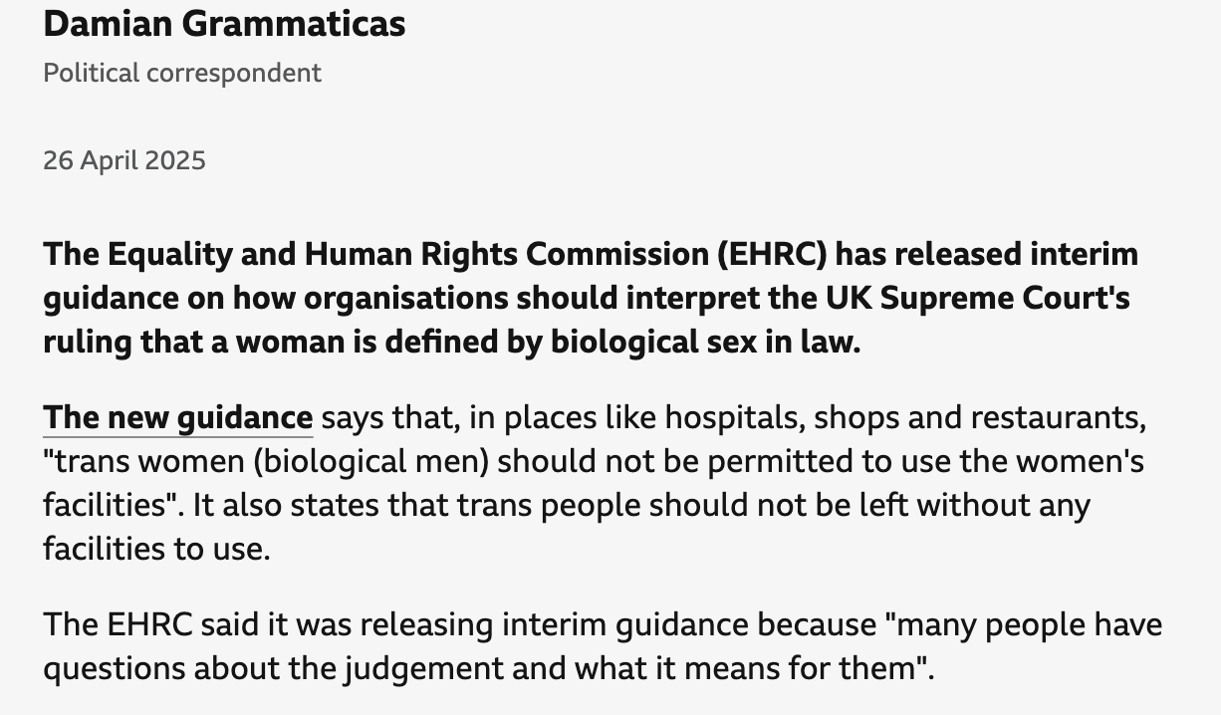
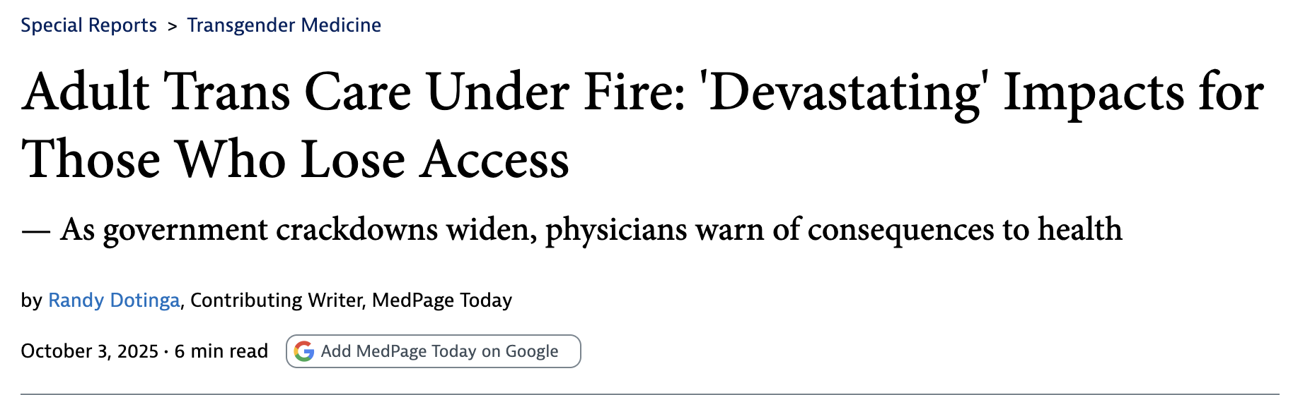

Slide 13

Bibliography
https://ilostat.ilo.org/blog/current-practices-in-measuring-sexual-orientation-and-gender-identity-in-population-censuses/
https://www.alchemer.com/resources/blog/how-to-write-survey-gender-questions/
https://www.researchgate.net/figure/Recommended-sexual-orientation-gender-identity-SOGI-questions_fig1_342061522
https://www.transhub.org.au/101/sex
https://population.org.nz/wp-content/uploads/2019/07/Veale-PANZ_Counting-Ourselves-presentation-uploaded2.pdf
https://www.statcan.gc.ca/en/statistical-programs/instrument/3901_Q1_V7
Guyan, Kevin, ‘Constructing a queer population? Asking about sexual orientation in Scotland’s 2022 census’. Journal of Gender Studies, vol. 31, iss. 6, 2022.
Hanes, Douglas William, Clouston, Sean A.P., ‘Ask Again: Including Gender Identity in Longitudinal Studies of Aging’. The Gerontologist, Vol. 61, No. 5, 2021, pg. 640-649.
Pega, Frank, Reisner, Sari, Sell, Randall, Veale, Jaimie, ‘Transgender Health: New Zealand’s Innovative Statistical Standard for Gender Identity’. American Journal of Public Health, Vol. 107, No. 2, February 2017, pg. 217-221.
Tate, Charlotte Chuck, Ledbetter, Jay N., Youssef, Cris P., ‘A Two-Question Method for Assessing Gender Categories in the Social and Medical Sciences’. Journal of Sex Research, Vol. 50, No. 8, 2013.
Westbrook, Laurel, Schilt, Kristen, ‘Doing Gender, Determing Gender: Transgender People, Gender Panics, and the Maintenance of the Sex/Gender/Sexuality System’. Gender & Society, Vol. 28, No. 1, February 2014.

