Slide 1

Factor or Network? Modeling the Complexity of Gender Minority Stress in Transgender Communities
Noah Pevie (he/him)
PhD Student
Methodology and Relationship/Sexual Science Lab
University of Western Ontario
Notes:
Hi, I’m Noah and today I’ll be talking about measurement modelling in the context of gender minority stress

Slide 2
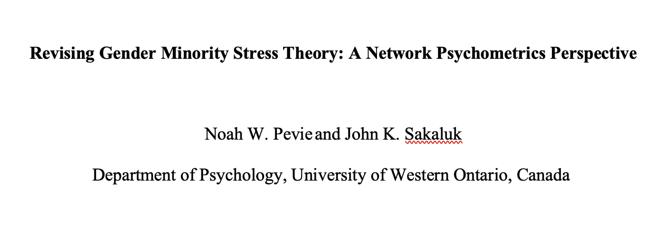

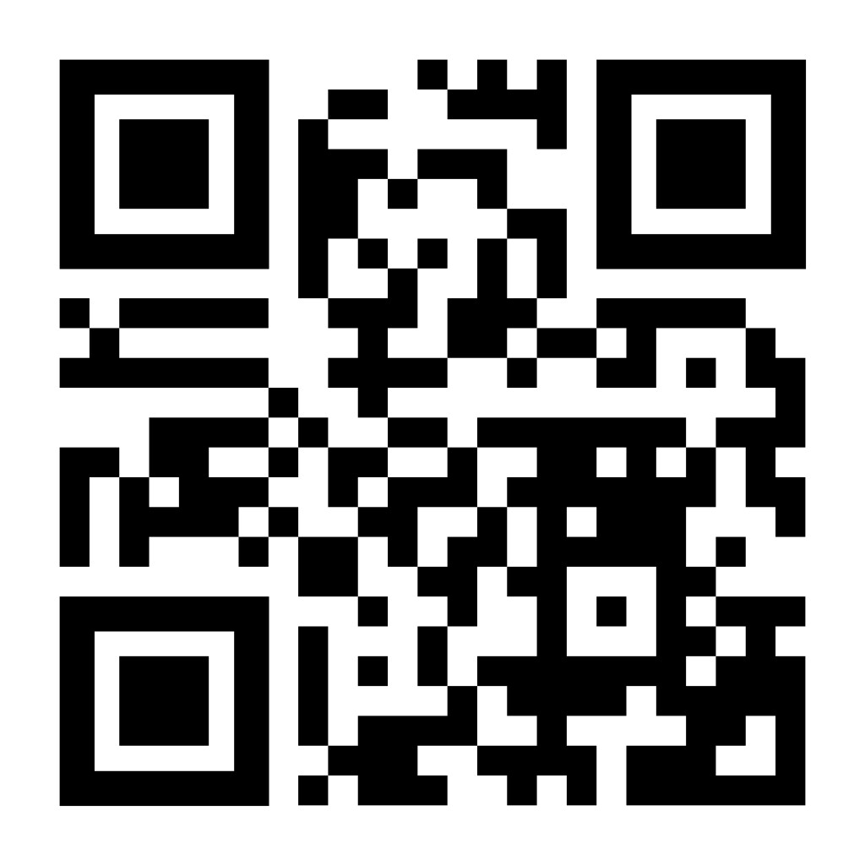
More Info About the Findings
Notes:
And before we start, if you’re interested in learning more, we have a pre-print up that you can access using this QR code!

Slide 3
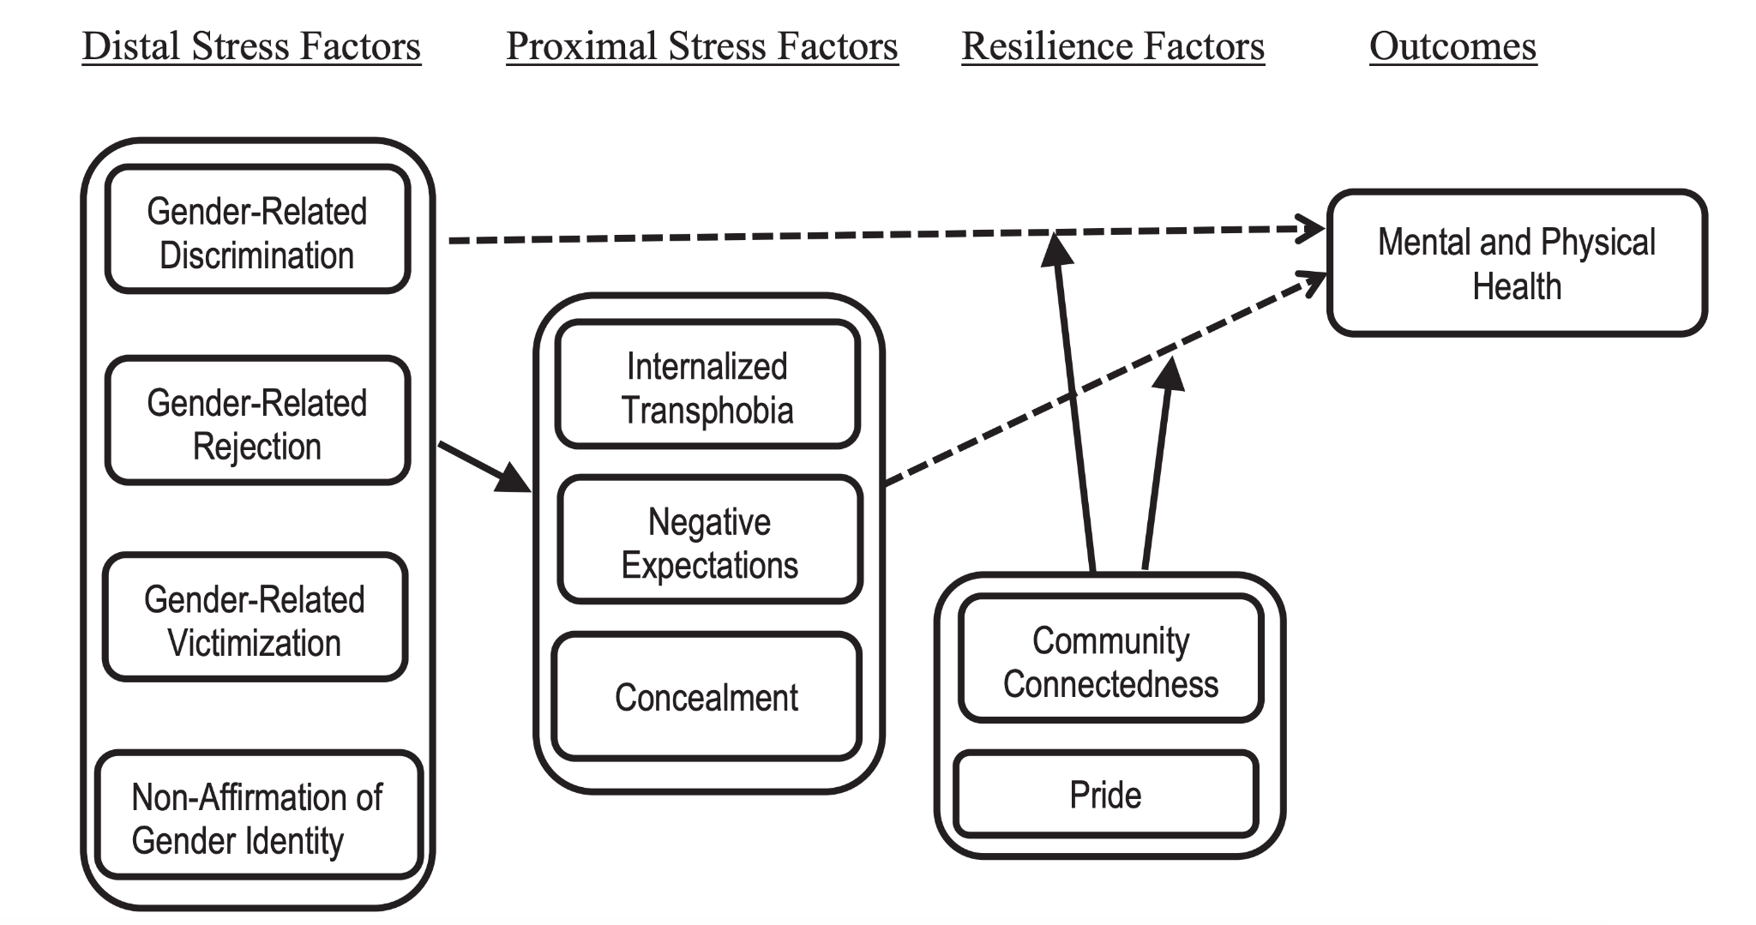
Gender Minority Stress → Poor Health
(Brooks, 1983; Meyer, 1995; 2003; Hendriks & Testa, 2012; Testa et al., 2015)
Notes:
Gender Minority Stress Theory is the most widely used framework for explaining why transgender and nonbinary people experience worse health outcomes. It proposes that the chronic social stress associated with being trans* leads to poor mental and physical health.

Slide 4
Gender Minority Stress → Poor Health
(Brooks, 1983; Meyer, 1995; 2003; Hendriks & Testa, 2012; Testa et al., 2015)
Notes:
These stressors are often split into 9 these conceptual domains, which you can see the nine domains here

Slide 5
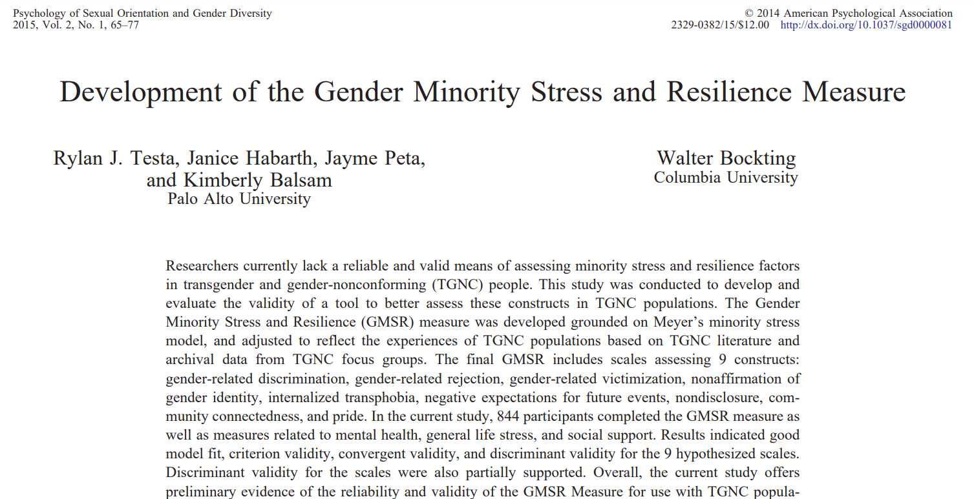
The GMSRM
Notes:
Researchers have since created the Gender Minority Stress and Resilience Measure was developed, and it has become the most commonly used measure in trans health research. This measure takes the nine conceptual domains I just mentioned and translates them into a nine-factor reflective latent variable model.
That’s a lot of words. And this is where I like to pause for a moment—because we’ve just translated a theory into a measurement model, which is a complicated process. So I want to step back and ask:
Researchers study gender minority stress to better understand these experiences and also develop interventions to reduce this stress. So, in an effort to standardize quantitative research in this area, the Gender Minority Stress and Resilence Measure was developed, which has become the most commonly used measure in trans health research. And this measure takes those 9 conceptual domains I just mentioned and converts them into converts them into a 9 factor reflective latent variable model. And that’s a lot of words. And here is where I like to take a bit of a pivot – because we have just translated a theory into a measurement model – and that’s a complicated process. And so I like to take a step back and ask what does it m important now to ask a kinda basic question of:

Slide 6

What Do Numbers Mean?
Notes:
What do numbers mean? I know this is a silly question, but it’s the core of a lot of what we do in the social sciences – we want to quantify thoughts, feelings, and behaviours. And in order to do that, we assign meaning to numbers through theory and measurement models.

Slide 7
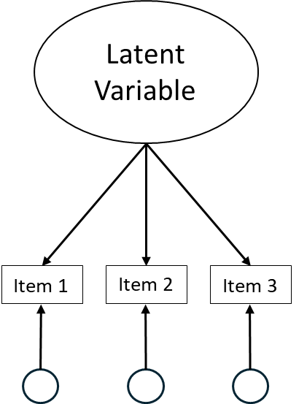
Most Measures Use Latent Variable Theory
Reflective
The latent variable is
CAUSING
people to respond to items on a measure differently
(Borsboom, 2005; Borsboom et al., 2003)
Notes:
And We often do this through the use of self-report measures. And researchers almost exclusively reflective latent variable models – if you’ve seen people do confirmatory or exploratory factor analysis, this is what I mean. But these models come with strong theoretical and statistical assumptions, chief among them being latent variables modelled together must be causally independent of one another.

Slide 8
Gender Minority Stress → Poor Health
(Brooks, 1983; Meyer, 1995; 2003; Hendriks & Testa, 2012; Testa et al., 2015)
Notes:
And if we flip back to gender minority stress theory – we can see clearly that we believe the four distal stress factors causally predict the three proximal stress factors. Which means a 9 factor reflective latent variable model might not be the best measurement model for GMST. And so, what happens when we create measurement models that do not align with our substantive theories.

Slide 9
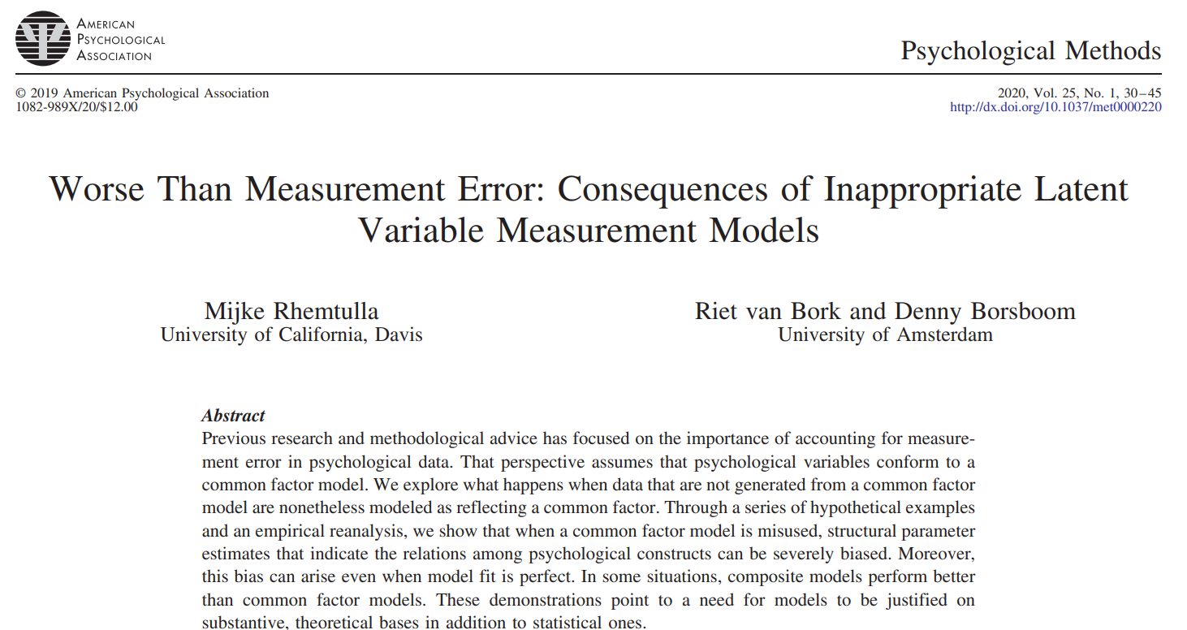
Measurement Begins with Theory
Notes:
TL;DR is it’s bad. Failing to align theory and measurement can result in biased parameter estimates, poor tests of hypotheses and theories, and, in the long run lead to ineffective interventions. So, what can we do if we notice this theory-measurement misalignment?

Slide 10
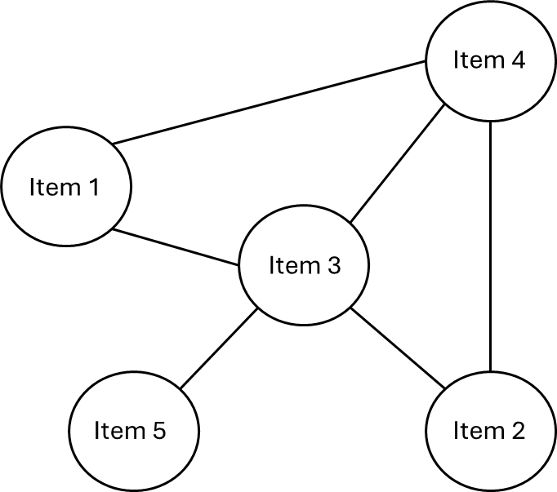
Whose Reflection is it Anyway?
Reflective
Psychometric Network
(Borsboom & Cramer, 2013; Isvoranu et al., 2022; Schmittmann et al., 2013)
Notes:
And that’s where psychometric network theory comes in for our work. It doesn’t not assume the existence of latent variables or causal hierarchies. Instead, the construct, so gender minority stress, is theorized to emerge through interactions between items, and these items uniquely predict one another (Borsboom & Cramer, 2013; Schmittmann et al., 2013).
But Psychometric network theory (PNT), in particular, has emerged as a novel psychometric perspective that has been generative in other areas of clinical and social psychological research and may ultimately be a more evidence-based framework for understanding patterns of gender minority stress.

Slide 11

Ways to Find Out
Psychometric Testing in R
Thought Experiments
Bollen (1989)
Edwards & Bagozzi (2000)
van Bork et al., (2019)
Rhemtulla et al. (2020)
Notes:
There are a couple ways to think critically about how we model constructs we care about, one of the ways being thought experiments. We don’t have time to touch on it today, but here are some core citations if your interested. What we will focus on, however, is an R package that helps us determine if our measure corresponds better to a latent variable model or a psychometric network model.

Slide 12
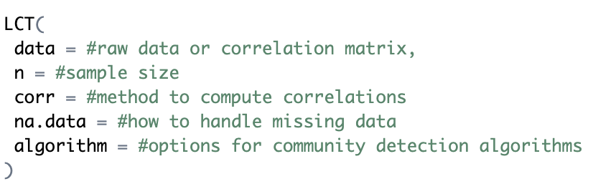
R-Specific Psychometric Packages
Loadings Comparison Test (LCT)
(Golino & Christensen , 2025)
Notes:
And that is the EGAnet package. In this package there is a function called the Loadings Comparison Test. In terms of the arguments you input, its very straightforward. You need you dataset that contains only the items from your self-report measure, you input the sample size you have, specify correlation and missing data preferences and you’re basically set.

Slide 13

Data Analysis: Loading Comparison Test
LCT::
(Christensen & Golino, 2021; Golino & Christensen , 2025)
Notes:
The key idea is behind this test is that factor models and network models can look statistically similar—but only when the true data-generating mechanism is a latent variable. The LCT compares traditional factor loadings in LVM’s to their network equivalents. And then a machine-learning algorithm uses the discrepancy between factor and network loadings to estimate whether the data were more likely generated by a factor structure or a network structure.

Slide 14

Methods: Secondary Data
Notes:
And so, as one component of our study, we used this LCT function to help determine if the Gender Minority Stress and Reslience Measure is better modeled as a latent variable or psychometric network.. So, we utilized a sample of 1006 trans and non-binary people from a recent study by Lindley and colleagues, who graciously uploaded their data to OSF.

Slide 15
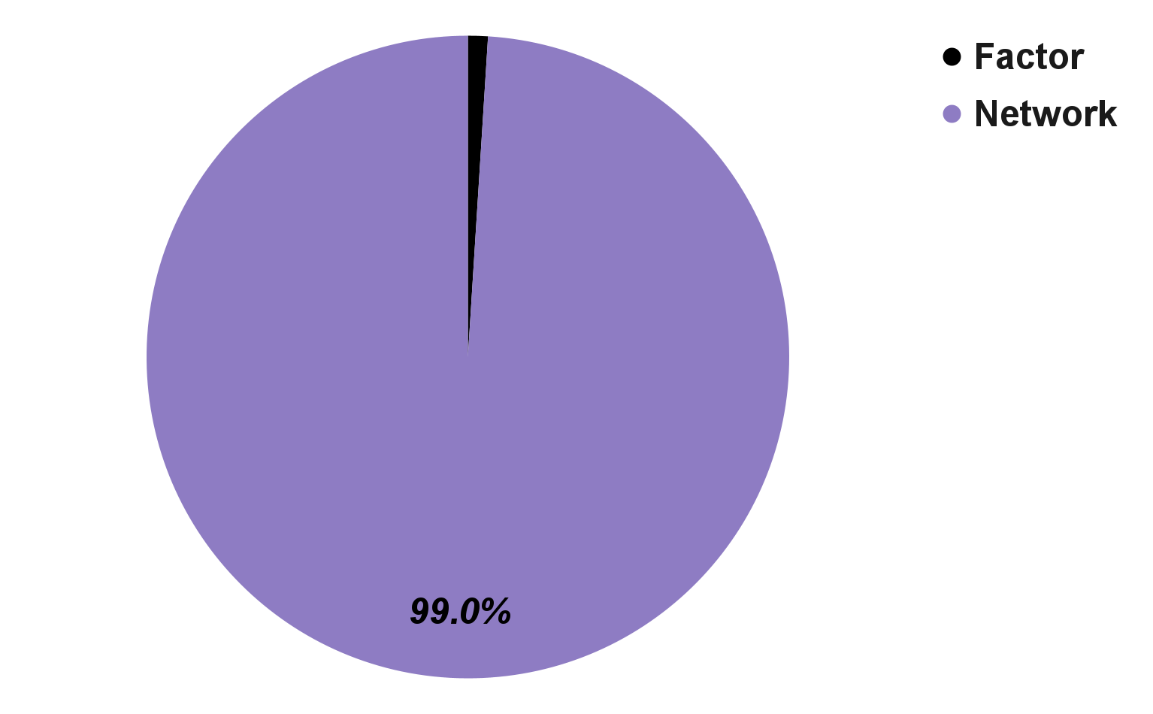
Loadings Comparison Test: Outputs
Empirical = “Network”
Bootstrap = “Network”
Notes:
And the last output it provides is a proportion of the bootstrap samples which were assigned as either having a factor or network structure. And for the GMSRM, 99% of bootstrap samples were classified as conforming to a network structure

Slide 16
Loadings Comparison Test: Output
Empirical = “Network”
Notes:
The first, called "empircial" tells us, based on our sample of 1006, do the patterns of covariance for the GMSRM behaves like a network or a latent variable and it's a network. The next is bootstrap, which shows us how stable the “empirical” classification is across bootstrap resamples.

Slide 17
Loadings Comparison Test
Empirical = “Network”
Bootstrap = “Network”
Notes:
And it stably predicted a network

Slide 18
Measurement–Intervention Alignment
Notes:
Why this matters comes back to intervention. If our goal in measuring gender minority stress is to reduce it, our models need to reflect how it’s actually experienced—by aligning theory, lived experience, and measurement. Latent variable models assume we reduce stress by targeting underlying factors which are expected to have downstream consequences on item responses, whereas network models take a systems approach and focus on the most influential or connected items. These different models lead to very different intervention strategies.
And so in terms of what this means and why it’s important, we come back to the idea of creating effective interventions. If part of the goal of quantifying GMS is to be able to reduce that stress, our measurement models need to reflect how it's actually experienced – and that means aligning theory, lived experience, and measurement modeling. Because the flow of causality between these two models not the same. Latent variable models assume we change stress by targeting underlying factors. But in network models, we work from a systems perspective, where we intervene by targeting the most connected or influential items. So these two models would require quite different intervention strategies.

Slide 19


Extra Special Thanks:
Dr. John Sakaluk

